Slide 1

Revolutionizing Model Railroading with AI:
Discover How ChatGPT Can Transform Your Hobby
Unlocking the Power of AI in Model Railroading
What ChatGPT Can Do for You Today (Not Someday)”
Pat Fleming
PatFlemingHtc@Gmail.com

Slide 2
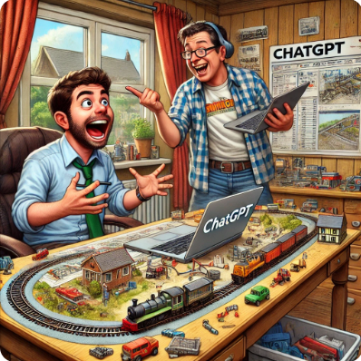
Agenda
How to Think About AI Tools
Why Use AI Tools
Why Choose ChatGPT Over Other AI Tools
Getting Access
Subscription Plans and Models
Custom GPTs
Working with Images
Prompting
Chat
Layout Planning
Operations Planning
Social Media
Electronics / Software
More Help…
Summary

Slide 3
AI Tools Why??

Slide 4
🛠️ How to Think About AI Tools
🚂 It's a Tool — Not a Replacement Use it like you'd use a track planning program or DCC controller — it's there to assist, not take over. 👨‍🏭 It's Another Member of Your Crew Always available to help you: - Write a newsletter - Troubleshoot wiring - Come up with scene ideas - Draft signs for your layout ⏱️ It Saves Time. 💡 It Boosts Creativity. 📚 It Teaches You. - No more endless Googling - Try new things with less trial-and-error - Learn history, electronics, and layout design—fast!

Slide 5
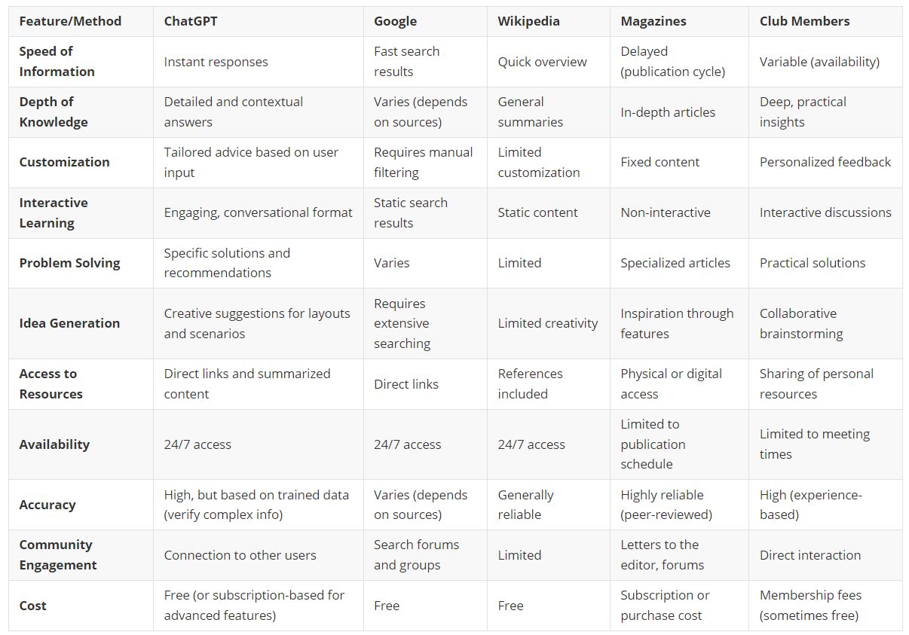
Why use AI Tools?

Slide 6
ChatGPT

Slide 7
🧠 Why Choose ChatGPT Over Other AI Tools?
Feature | ChatGPT (OpenAI) | Gemini (Google DeepMind) | Grok (xAI)
Free Access | ✅ GPT-3.5 (text-only) and GPT-4o mini (limited multimodal) | ✅ Gemini 2.5 Flash-Lite (text-only) | ✅ Grok 3 Mini (text-only)
Multimodal Support | ✅ GPT-4o (text, images, audio, video) | ✅ Gemini 2.5 Pro (text, images, audio, video) | ✅ Grok 3 (text, images, audio)
Memory & Context | ✅ Customizable memory settings | ❌ Limited context retention | ❌ Limited context retention
User Interface | ✅ Clean, intuitive, and accessible | ✅ Integrated with Google services (e.g., Gmail, Docs) | ❌ Integrated with X (formerly Twitter), limited external integrations
Customization | ✅ Custom GPTs and prompt engineering | ✅ Customizable responses and tone adjustments | ❌ Limited customization options
Pricing | 💰 Free tier available; Plus subscription for advanced features | 💰 Free tier available; Premium features require subscription | 💰 Premium subscription required for full access
Trust & Safety | ✅ Strong safety protocols and content moderation | ✅ Robust safety measures and content moderation | ⚠️ Recent controversies regarding content moderation and safety
Ideal For | 🛠️ Hobbyists, educators, content creators, and developers | 🔍 Professionals requiring real-time information and integration with Google services | 🐦 Social media enthusiasts and users seeking edgy responses

Slide 8
CHATGPT HISTORY
Date | Version Name | Description
June 2018 | GPT-1 | First Generative Pre-trained Transformer (proof-of-concept).
February 2019 | GPT-2 | More capable, initially withheld due to concerns about potential misuse.
June 2020 | GPT-3 | Major breakthrough in natural language processing and generation.
November 2022 | ChatGPT (based on GPT-3.5) | First public release of ChatGPT — made AI conversational and approachable.
March 2023 | GPT-4 | Multimodal model (text + image inputs) with improved reasoning and accuracy.
July 2023 | ChatGPT Mini | Lightweight version for mobile and embedded devices.
November 2023 | GPT-4o (Omni) | First fully multimodal model: fast, accurate, understands text, image, and voice.
May 2024 | Voice & Vision Mode | Enabled users to speak with ChatGPT and show it photos for live analysis.
2025 (Now) | ChatGPT with Memory | Remembers your preferences and ongoing projects (like your layout goals).
Initial Development: ChatGPT is developed by OpenAI, an artificial intelligence research organization.
Founding: OpenAI was founded in December 2015 by Elon Musk, Sam Altman, Greg Brockman, Ilya Sutskever, John Schulman, and Wojciech Zaremba, among others.
Funding: OpenAI started with a pledge of $1 billion from its founders and other investors. In 2019, OpenAI LP received a $1 billion investment from Microsoft as part of a strategic partnership.

Slide 9

Getting ACCESs

Slide 10
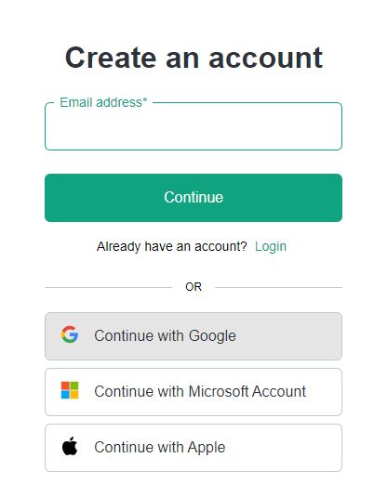
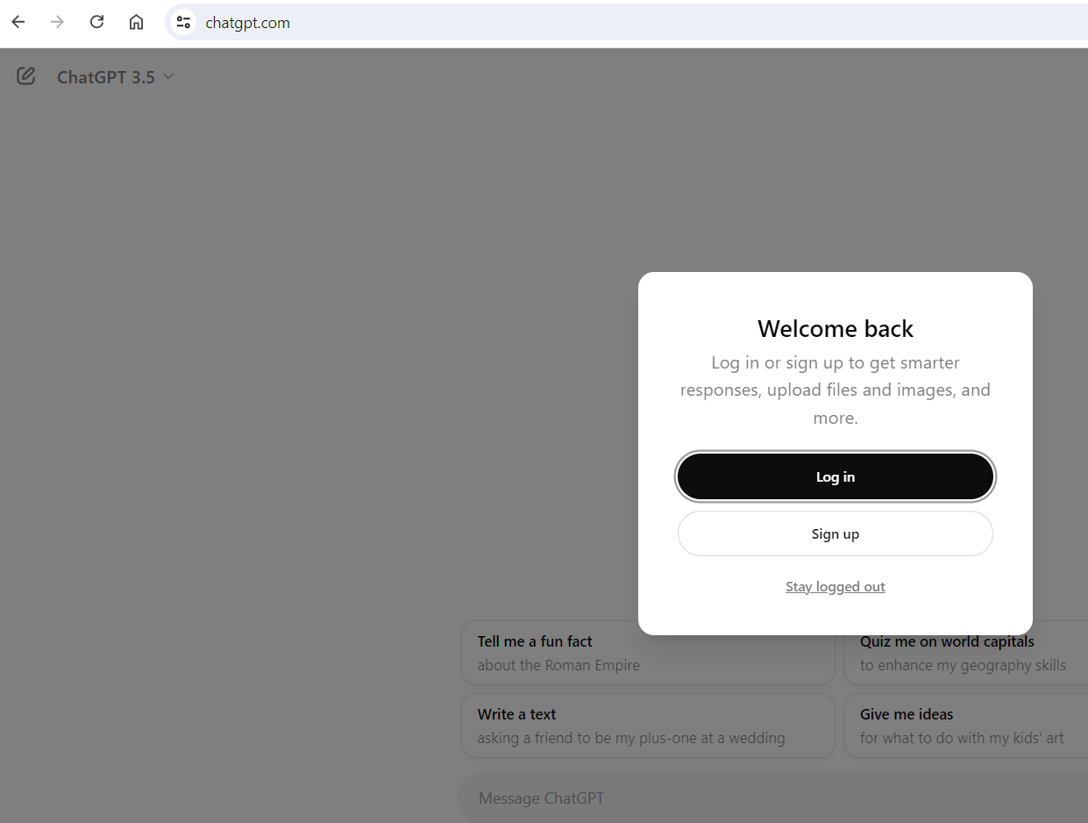
CHATGPT Sign out / Login
User:
chatgpt.com
Tip:
Use Google for easy access
User:
Click to Signup

Slide 11
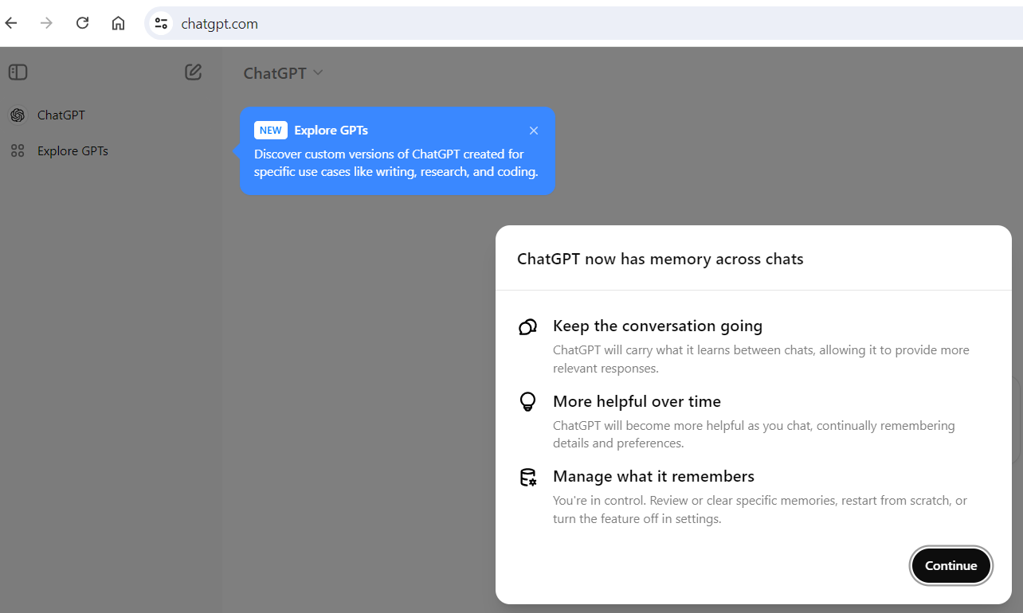
Initial Login
Rembers information between chats

Slide 12
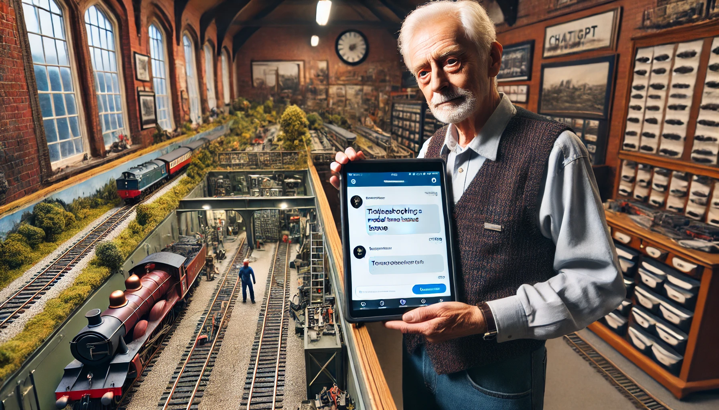
Subscription plans and models
“Start with the basics”

Slide 13
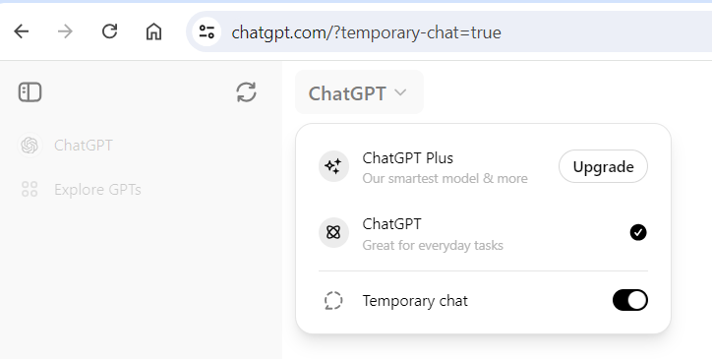
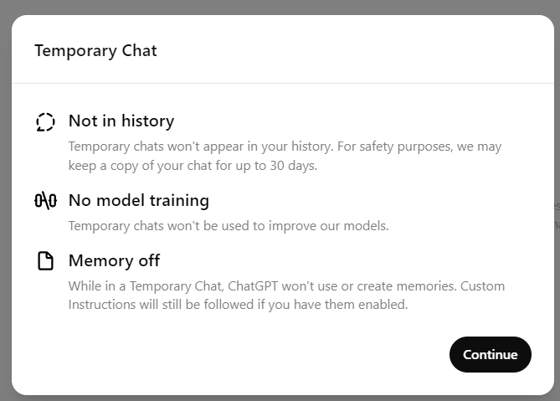
Choice of Plans…
Choice of ChatGPT Plans
Default plan at no cost
Temporary (New)

Slide 14
ChatGPT Free vs Plus — What Can You Really Do?
Feature | ChatGPT Free Version ($0) | ChatGPT Plus Version ($20/month)
Access | Limited during peak times | Full access anytime
Response Speed | Standard | Faster
Model Access | GPT-4o (latest) | GPT-4o (latest) + 6 more
Web Access | Available | Available
Image Generation | Available (slow) | Available (faster)
Deep Research | 5 (month) | 25 (month)
File Uploads | Available | Available
Voice Input (Mobile App) | Not available | Available
Create Custom GPTs | Not available | Available
Usage Limits | Limited daily usage | Higher usage limits
New Features | Standard release | Early access to new features
Pricing | Free | $20/month

Slide 15
ChatGPT Free Version — 2025 Update
• Guaranteed access: GPT-3.5 for text-based chat, reliable for most tasks. • Occasional access: GPT-4o mini (lightweight GPT-4o variant) may sometimes be available, but is limited and not guaranteed. • No access to full GPT-4o (multimodal, advanced features), image/file uploads, or voice input. • Other limits: No chat memory, standard speeds, and possible wait times during peak usage.

Slide 16
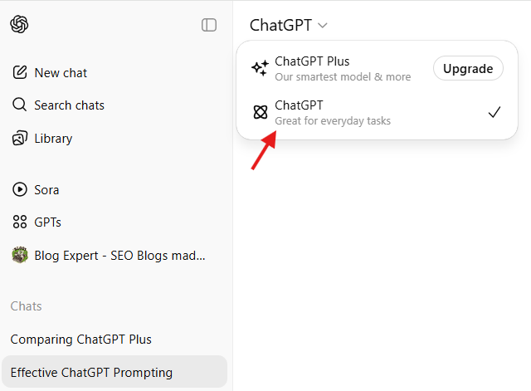
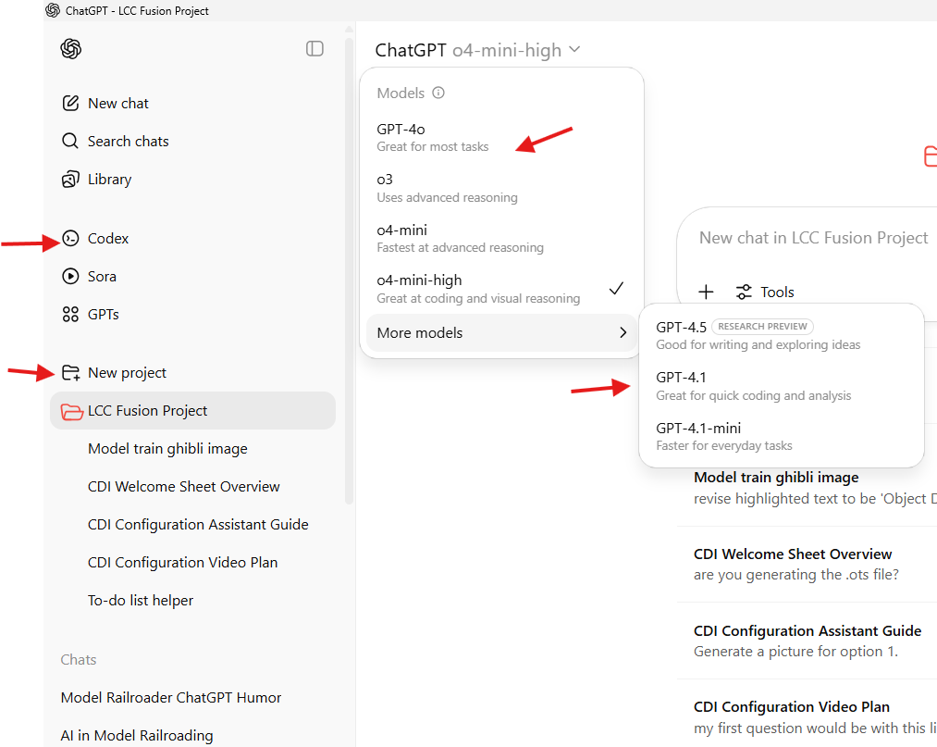
ChatGPT Free VS Pro
Side by Side

Slide 17
CHOICE OF MODELS: What’s Available in 2025?
TIP: Use GPT-4o (Omni) for best results
Model | Available To | Strengths
GPT-3.5 | Free & Plus | Fast and lightweight. Great for simple Q&A and writing.
GPT-4o | Plus only | Latest, fastest, most accurate. Multimodal (text + image + audio).
GPT-4o mini | Plus only (optional) | Lighter, faster variant. Good for quick tasks.
Task | Best Model | Why
Planning a layout | GPT-3.5 | Fast and free
Uploading layout photos | GPT-4o | Only model with image understanding
Writing newsletters/blogs | GPT-3.5 or 4o | 3.5 is fine; 4o adds polish
Troubleshooting electronics | GPT-4o | Handles schematics/images, more technical
Arduino code help | GPT-4o mini | Fast, small answers

Slide 18
CUSTOM GPTs

Slide 19
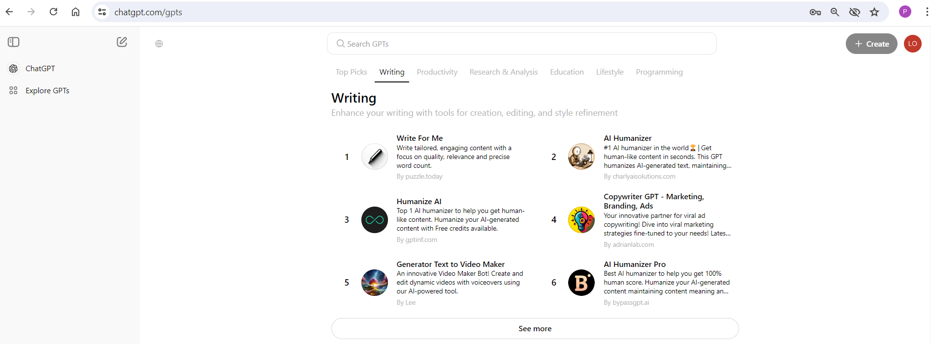
CHATGPT PLUS: Custom GPT
Train your own model and share with others
Work with multiple GPTs
Library of existing GPT models

Slide 20
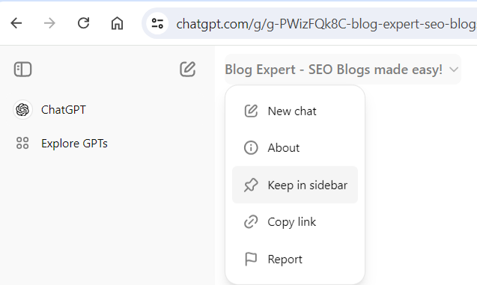
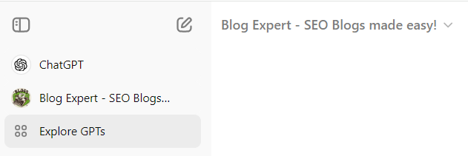
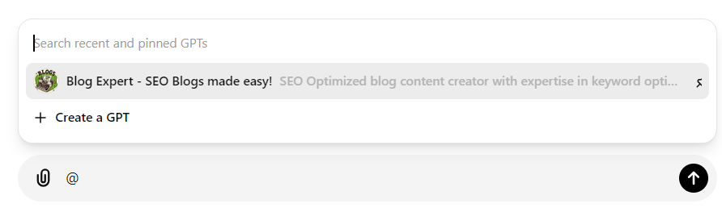
CUSTOM Models (Cont)
Now shows in side bar of GPTs you can quickly reference
If you like it, add it to side bar for quick reference
Type ‘@’ to select 2nd GPT ‘expert’ into the chat

Slide 21
Using Projects in ChatGPT Plus — Your Hobby Assistant
• Organize your layout ideas, wiring plans, and scripts in one place. • Save ongoing conversations and context for easy continuation. • Quickly switch between multiple projects (e.g., “Layout Design,” “Newsletter Writing”). • Share project-specific custom GPTs and prompts. • Helps keep your work neat, focused, and accessible anytime. • Perfect for multi-phase hobbies like model railroading with complex tasks.

Slide 22

Working with images

Slide 23
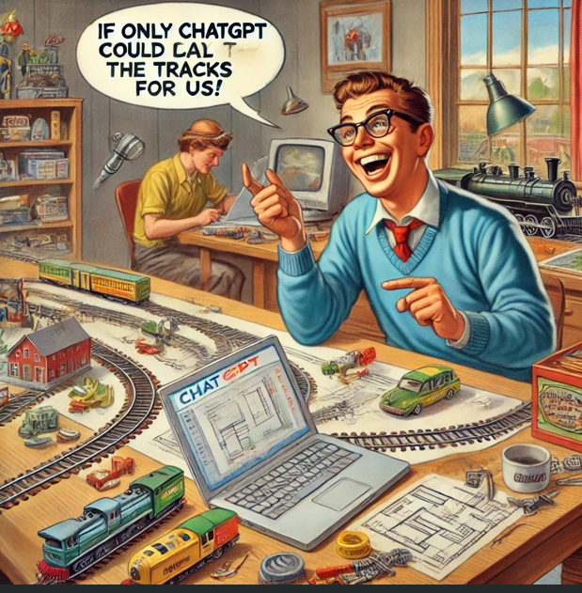

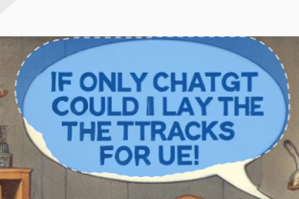
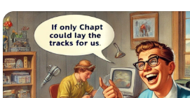
CHATGPT PLUS: Creating images (2024)
Prompt 1: create a humor image of a model railroader using ChatGPT with a friend for their layout (title slide)
Prompt 2: revise this image by adding a joke to it (see right)
Actual Joke: "If only ChatGPT could lay the tracks for us!"
Issues:
Spelling
To Fix: click on image, select the revision tool, highlight area to revise, enter what to be changed (see below for correction)
Edit Icon

Slide 24
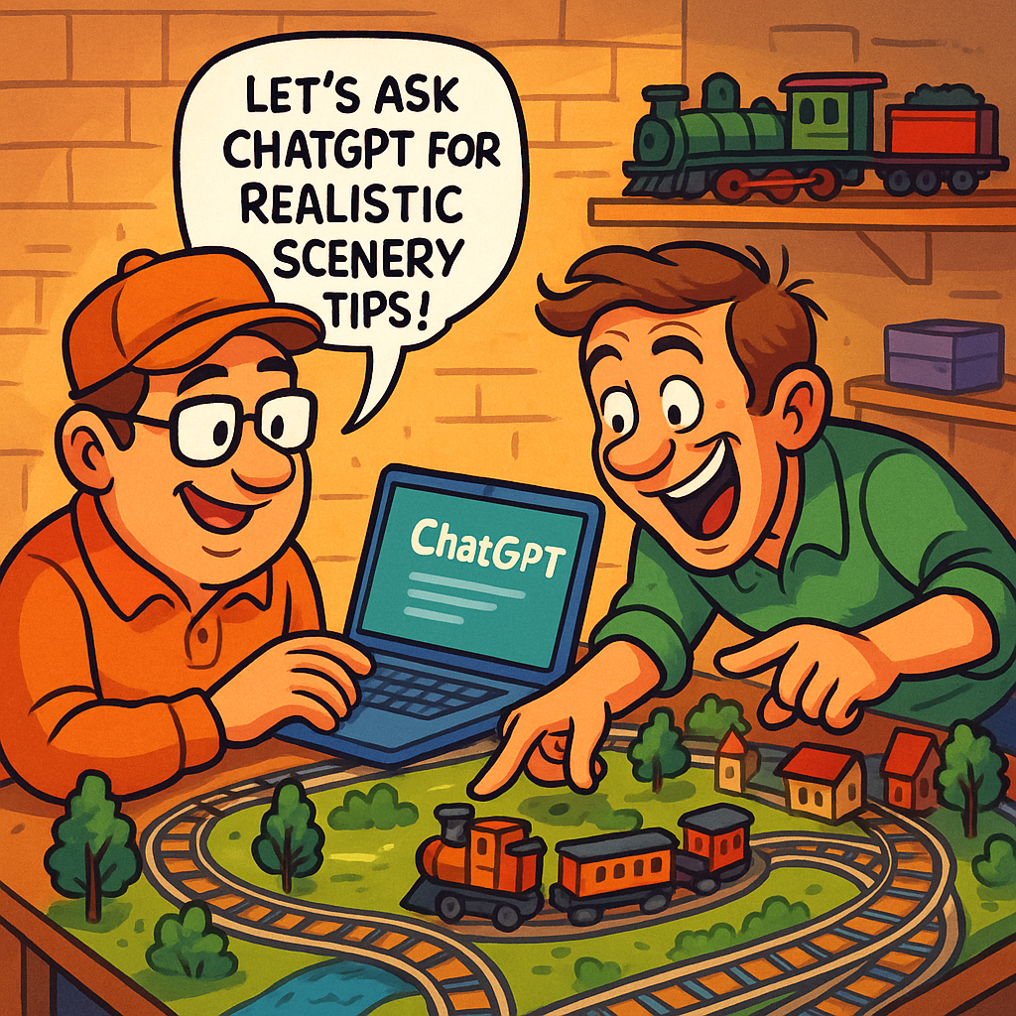
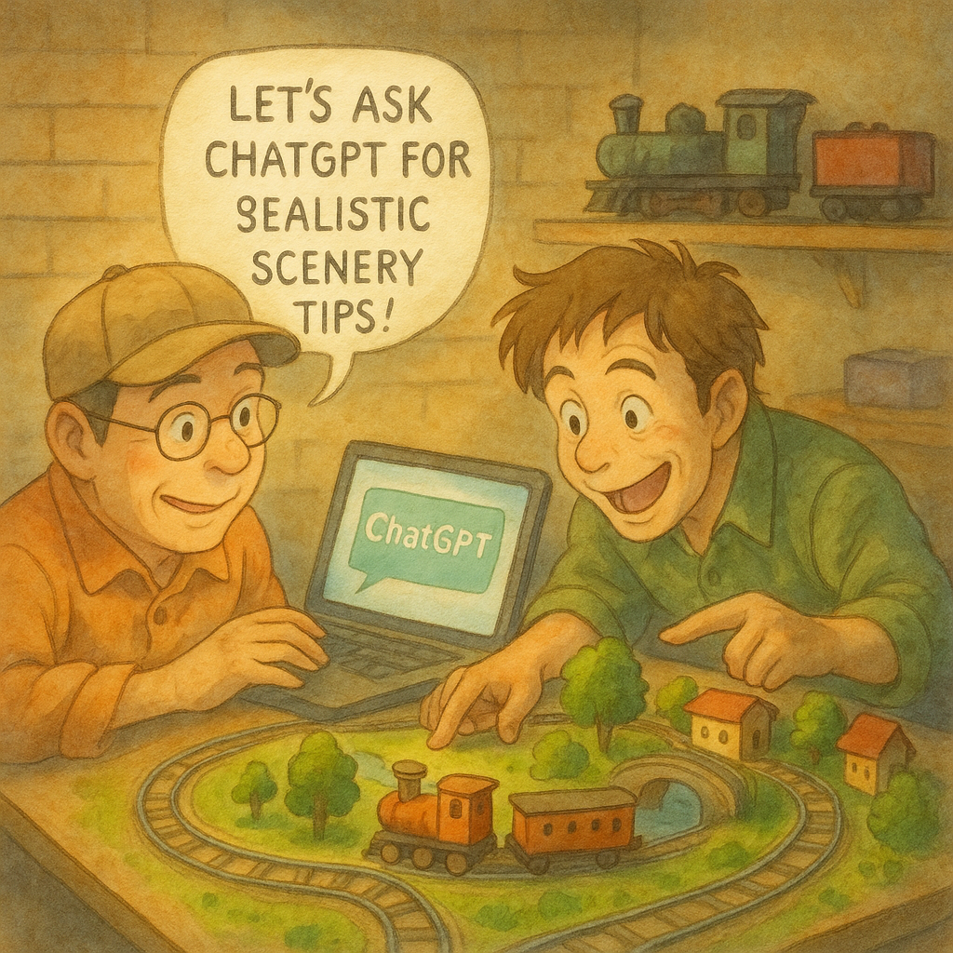
CHATGPT PLUS: Creating images (2025)
Ghibli‑inspired watercolor style

Slide 25
PROMPTING

Slide 26
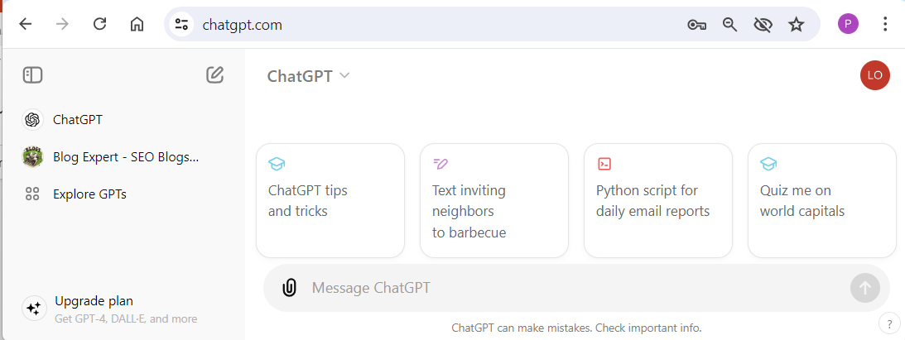
Prompting…
ChatGPT prompting involves giving specific instructions or questions to ChatGPT, a conversational AI, to get useful and relevant responses.
User:
Prompt: Enter your request here

Slide 27
Prompting: Guidelines
Be Clear and Specific: The more specific your question or request, the better the response. Instead of asking "Tell me about history," you could ask, "Can you tell me about the causes of World War I?“
Ask Open-Ended Questions: If you want a detailed response, ask open-ended questions. For example, "What are the benefits of renewable energy?" instead of "Is renewable energy good?“
Provide Context:
If your question relates to a specific topic or scenario, providing context helps ChatGPT give a more accurate response. For instance, "In the context of modern web development, what are the pros and cons of using React.js?“
Break Down Complex Questions: If you have a complex question, break it into smaller parts. Instead of asking, "How do I start a business?", you could ask, "What are the first steps to starting a business?" followed by "How do I create a business plan?“
Iterate and Refine: If the response isn't quite what you wanted, refine your question or ask follow-up questions to get closer to the information you need.

Slide 28
CHAT

Slide 29
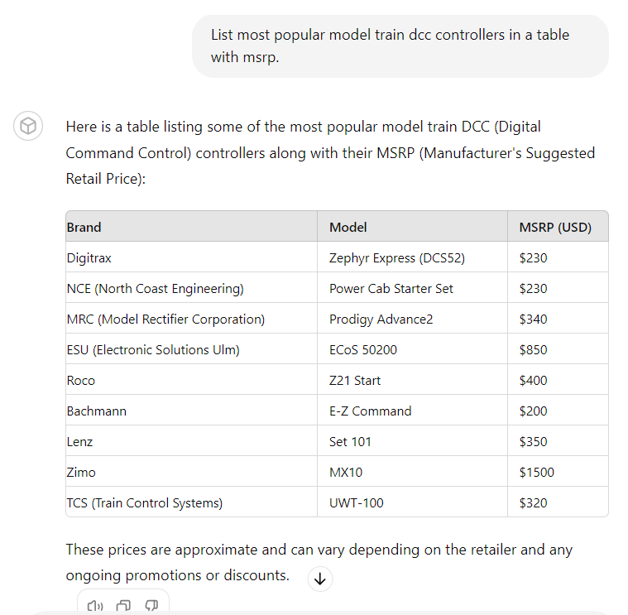
Overview of a “Chat”
User:
Prompt
ChatGPT:
Interpretation of user’s prompt
ChatGPT:
Response as a table
ChatGPT:
Click to scroll to bottom of response
ChatGPT:
Tool Icons: Read aloud, Copy, Bad Response

Slide 30
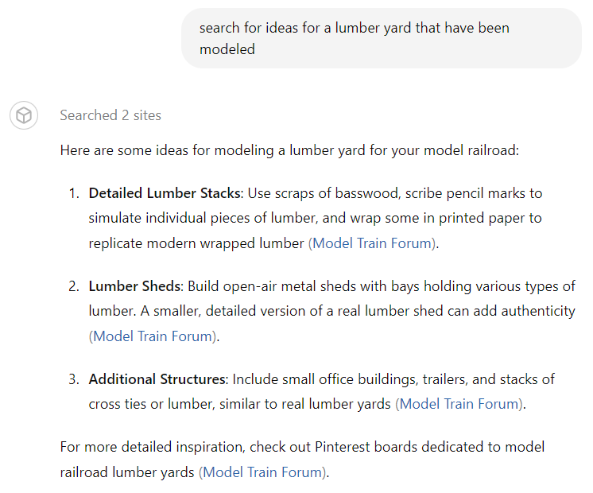
Getting ideas
User:
Prompt
ChatGPT:
List of ideas
ChatGPT:
Links to sources

Slide 31
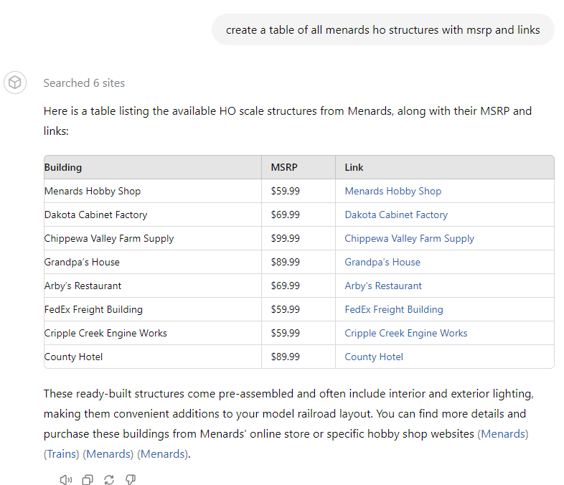
Refining Further…

Slide 32
Layout planning

Slide 33
Generate Ideas Prompt: are there any more topics i should be adding, more usage examples/prompts by modelers. Show as a table for .ppt
Topic | Example Prompt | Sample ChatGPT Response (Summary)
Scenery & Layout Design | Suggest 5 realistic small industries for a 4x8 HO layout. | Grain elevator, lumber yard, fuel depot, warehouse, coal mine.
Historical Research | Typical freight car types used by Southern Pacific in the 1950s? | Covered hoppers, tank cars, boxcars, flatcars, gondolas.
Electronics & Automation | Write Arduino code for 2 servos controlling turnout motors. | Code snippet showing Servo.attach() and servo.write() calls.
Troubleshooting & Repairs | Why does my DCC throttle lose signal intermittently? | Check wiring, track connections, shorts, and firmware updates.
Creative Storytelling | Write a short story about a day for a small line dispatcher. | Dispatcher coordinates pickups, calls yardmaster, manages trains.
Club & Social Media | Draft newsletter article for upcoming train show. | Event details, layouts, vendors, workshops, special demos.
Building & Kitbashing | Best practices for assembling resin freight car kits? | Clean parts, super glue, test fit, sand edges, prime before painting.
Project Management | Create a checklist to finish layout by next Christmas. | Track and wiring by June, scenery by August, painting by October, etc.

Slide 34
Generate Ideas Prompt: Suggest 5 realistic small industries suitable for a 4x8 HO scale layout, formatted as a table for using with .ppt
Industry | Description | Typical Rail Traffic
Team Track / Freight House | A general-purpose track for loading/unloading a variety of goods | Boxcars, flatcars, reefers
Lumber Yard | Receives dimensional lumber, plywood, or logs for local distribution | Flatcars, gondolas, boxcars
Concrete / Ready-Mix Plant | Mixes concrete from delivered sand, gravel, and cement | Covered hoppers, open hoppers
Small Brewery or Beverage Distributor | Receives ingredients, ships bottled/canned beverages | Boxcars, tank cars, grain hoppers
Machine Shop / Light Manufacturing | Produces parts or tools; ships finished goods | Boxcars, flatcars

Slide 35
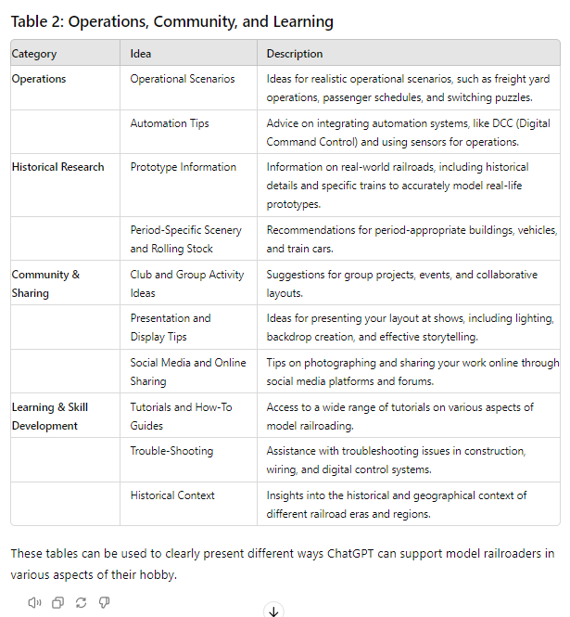
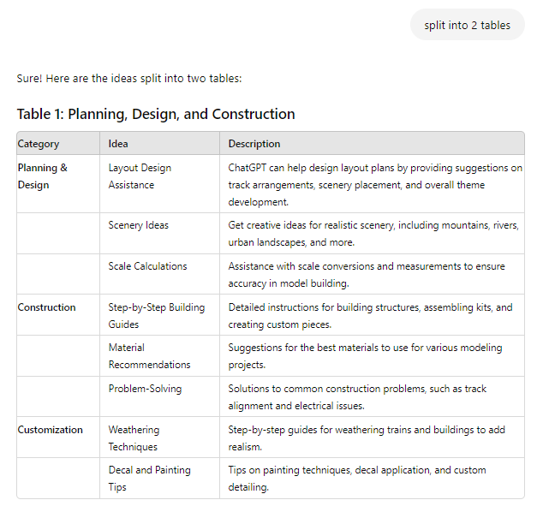
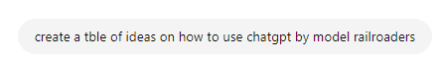
Generate Ideas Prompt 1: create table of ways CHATGPT can help with model railroading PROMPT 2: split into 2 tables

Slide 36
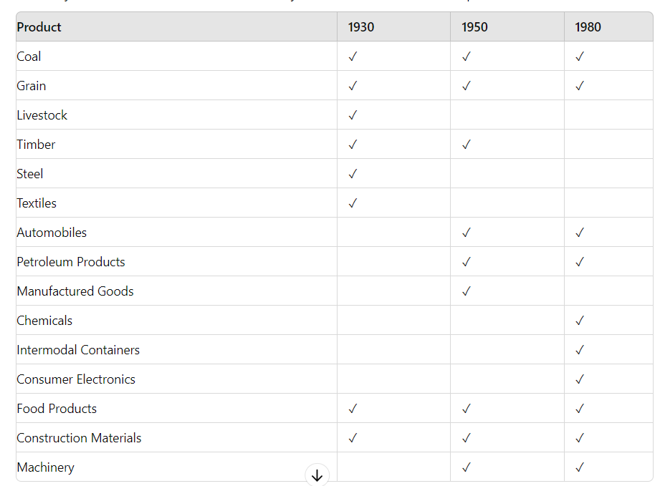
Planning for Industries Prompt: Create a table of the most common products delivered by trains for the years 1930, 1950 and 1980

Slide 37
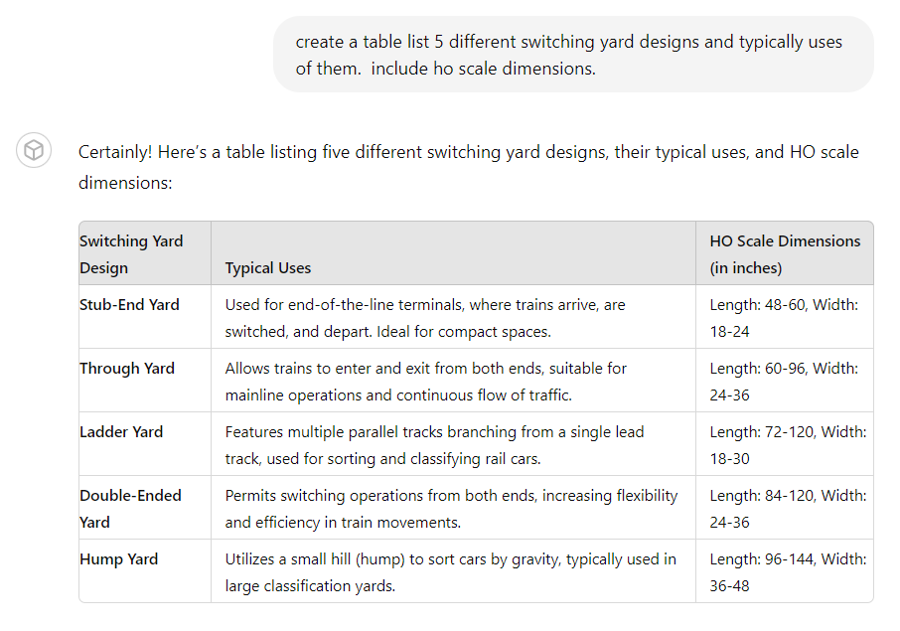
Layout Design: Switching Yard Designs Prompt: create a table listing 5 different switching yard designs and typical uses of them. Include ho scale dimensions.
Versatile Yard Configurations: Choose from stub-end, through, ladder, double-ended, or hump yards to suit different operational needs and layout sizes.
Realistic Operations: Each yard design supports specific types of rail operations, from sorting and classifying rail cars to managing continuous mainline traffic.
Optimized for HO Scale: Dimensions provided for each yard design ensure they fit well within typical HO scale layouts, balancing functionality and space constraints.

Slide 38
Design: Small Industries for HO Scale Layouts Prompt: list in a table 5 industries I can place in a small area at the back of my ho layout
Enhance Operational Variety:
Adding different industries such as grain elevators, warehouses, and fuel depots can create more interesting switching operations and realistic freight movements.
Space-Efficient Industries: These industries are ideal for fitting into small areas at the back of your layout, maximizing the use of available space without compromising detail or realism.
Diverse Rolling Stock: Incorporating these industries allows the use of various types of rolling stock, including covered hoppers, boxcars, and tank cars, adding to the visual appeal and operational complexity.

Slide 39
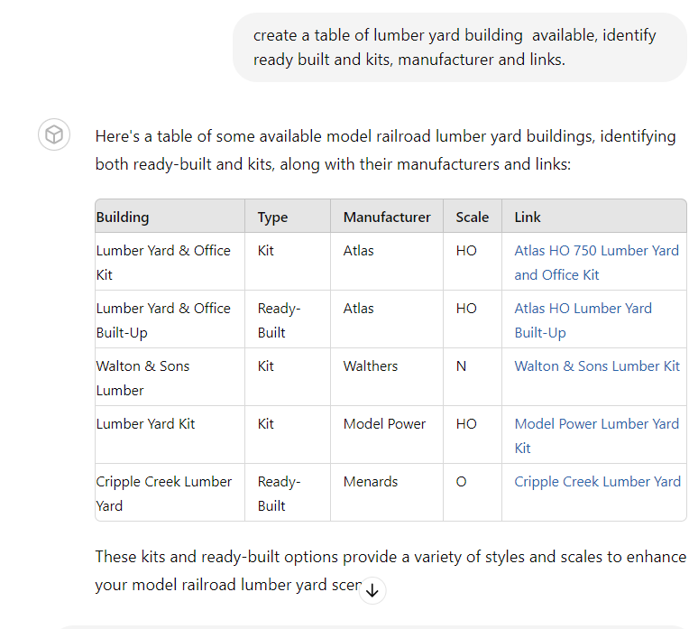
DESIGN: Getting ideas
Prompt: create a table of lumber yard building available, identify ready built and kits, manufacturer and links
Classic Industrial Theme: A lumber yard adds a traditional and easily recognizable industry to your layout, enhancing the overall theme and realism.
Versatile Operations: Supports a variety of freight activities, including loading and unloading of timber and lumber products, providing engaging switching operations.
Rolling Stock Variety: Utilizes flatcars and gondolas, adding diversity to your train consists and increasing visual interest on your layout.
Space Efficient: Suitable for small areas at the back of your layout, making effective use of limited space while maintaining operational
complexity.

Slide 40
layout: Assistance
PROMPT: creative ideas for maximizing space and achieving realistic scenes.
Space Maximization Techniques
Multi-Level Layouts:
Helix: Incorporate a helix to connect multiple levels of your layout, allowing for a greater run length without consuming additional floor space.
Staging Yards: Place staging yards on lower levels to store trains out of sight, freeing up visible space for scenic elements.
Modular Design:
Portable Modules: Use modular sections that can be rearranged or expanded as needed. This also makes transportation and setup easier for exhibitions.
Folding/Tabletop Layouts: Design layouts that can be folded or placed on tabletops to save space when not in use.
Vertical Scenery:
Elevated Tracks: Create elevated track sections using bridges and trestles to add interest and save ground space for other scenery elements.
Backdrop Scenes: Use painted or printed backdrops to extend the visual depth of your layout without taking up physical space.
Hidden Storage:
Under-Table Storage: Utilize the space beneath your layout for storing rolling stock, tools, and materials.
Lift-Out Sections: Design lift-out sections that can be removed to access hidden storage or maintenance areas.

Slide 41
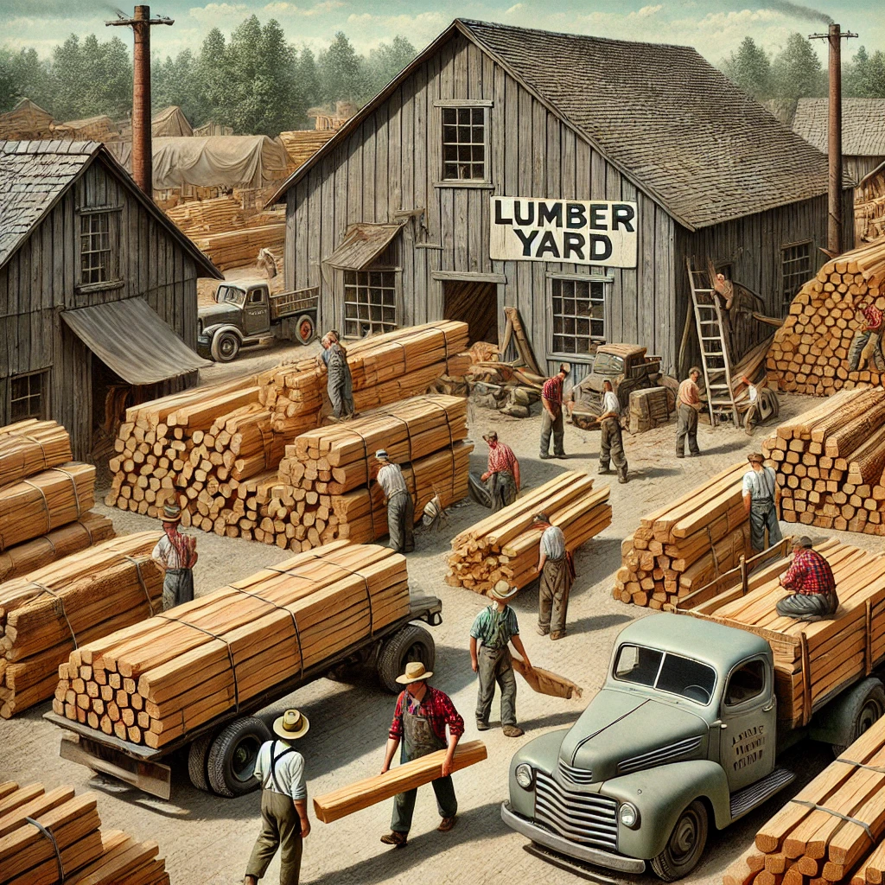
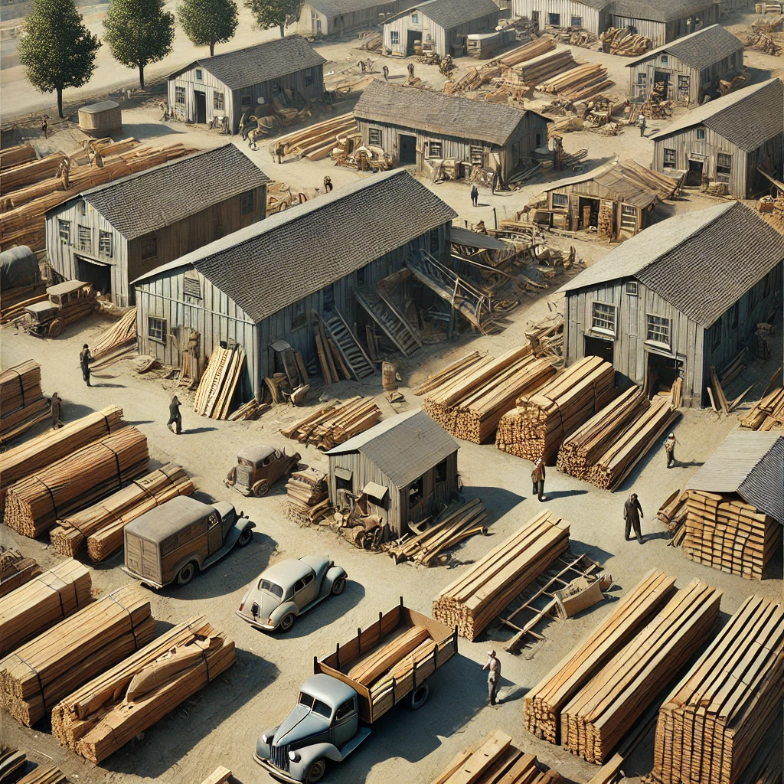
layout: Assistance (cont.)
PROMPT: image of a 1950 lumber yard
PROMPT: top down view with more yard buildings added

Slide 42
layout: Assistance (cont.)
PROMPT: creative ideas for maximizing space and achieving realistic scenes.
Realistic Scene Techniques
Detailed Scenery:
Layering: Use multiple layers of scenery materials (ground cover, static grass, bushes, trees) to create a natural and realistic look.
Variety: Mix different textures and colors to avoid monotony. Use fine details like rocks, debris, and small plants to enhance realism.
Prototypical Features:
Research: Study real-world locations and railroads to replicate prototypical features such as specific buildings, industries, and track arrangements.
Landforms: Incorporate natural landforms like hills, valleys, rivers, and lakes. Sculpting terrain using foam, plaster, or other materials adds realism.
Weathering:
Rolling Stock and Structures: Apply weathering techniques to give your trains and buildings a used, aged appearance. Use paint, powders, and washes to simulate rust, dirt, and wear.
Ground Cover: Add weathering to roads, tracks, and ground surfaces to reflect the effects of use and weather conditions.
Lighting:
Day and Night Effects: Use lighting to create different times of day. Install LEDs in buildings, streetlights, and vehicles to enhance nighttime scenes.
Spotlighting: Highlight key areas or scenes with focused lighting to draw attention and add drama.
Figures and Vehicles:
Scale Figures: Place scale figures in realistic poses and locations to bring scenes to life. Position them performing tasks related to the scene, like loading cargo or waiting at a station.
Vehicles: Add vehicles that match the era and location of your layout. Position them on roads, at crossings, or in parking areas.
Sound:
Sound Effects: Use sound modules to add realistic sounds like train whistles, engine noises, and ambient sounds (e.g., birds, water flowing).
Interactive Elements: Include sound triggers activated by passing trains or visitor interaction.

Slide 43
layout: Assistance (cont.)
PROMPT: creative ideas for maximizing space and achieving realistic scenes.
Example Layout Scenario: Small Urban Setting
Space Maximization:
Multi-Level Design: Create a small urban layout with an upper level representing elevated tracks and a lower level with street scenes and a subway.
Modular Sections: Design the layout in modules that can be reconfigured or expanded. Use a fold-out section for an additional industrial area.
Realistic Scene:
Urban Details: Include detailed buildings with storefronts, residential areas, and industrial facilities. Add sidewalks, streetlights, and traffic signals.
Weathering: Apply weathering to buildings, streets, and vehicles to reflect urban wear and tear.
Figures: Populate the streets with figures in various activities such as walking, shopping, and working.
Lighting: Use LEDs to light up buildings and streetlights. Create a night scene by dimming room lights and using the layout’s built-in lighting.
By combining these space maximization techniques and realistic scene enhancements, you can create a captivating and immersive model railroad layout that feels larger than it actually is and offers a highly detailed and lifelike experience.

Slide 44
Operations

Slide 45
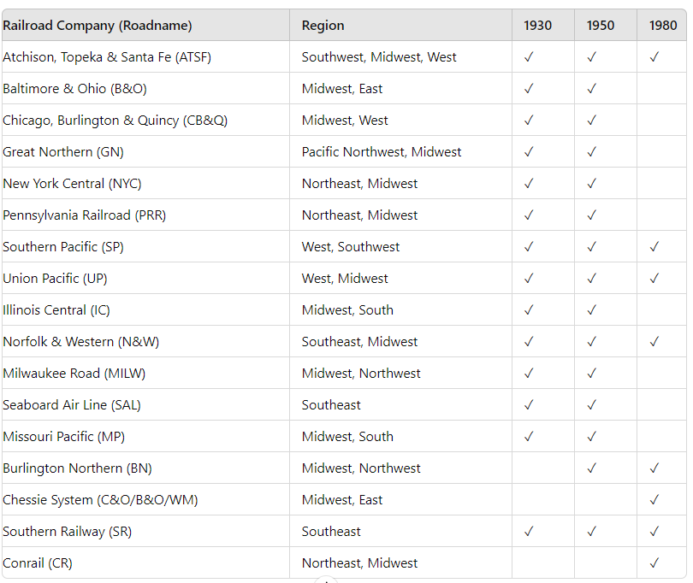
Planning for Operations Prompt: for the same years, create a table of the road names and their region within us.

Slide 46
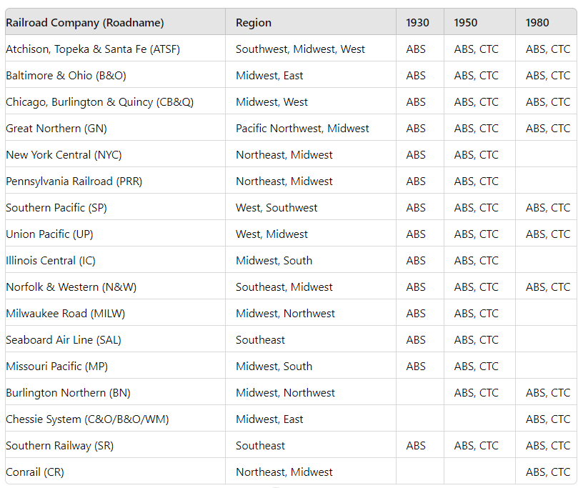
Planning for operations (cont) Prompt: for the years mentioned earlier, show road names use of ctc and abs

Slide 47
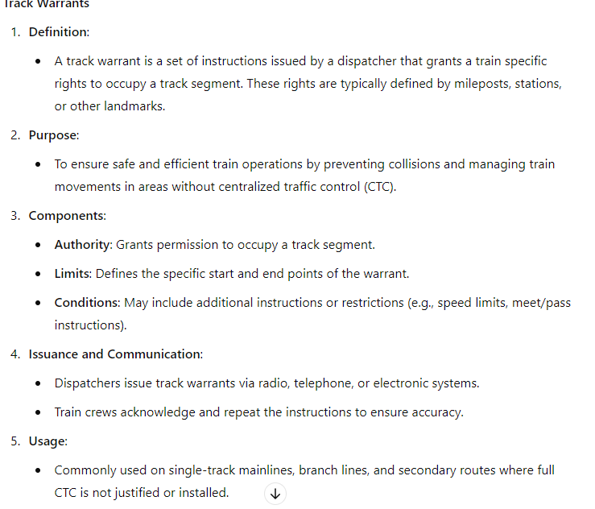
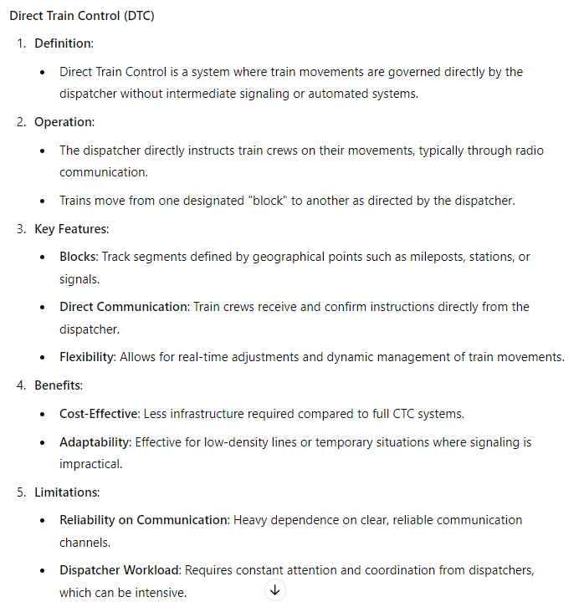
Planning for operations (cont) prompt: summarize track warrants/direct train control operations used by prototypical trains

Slide 48
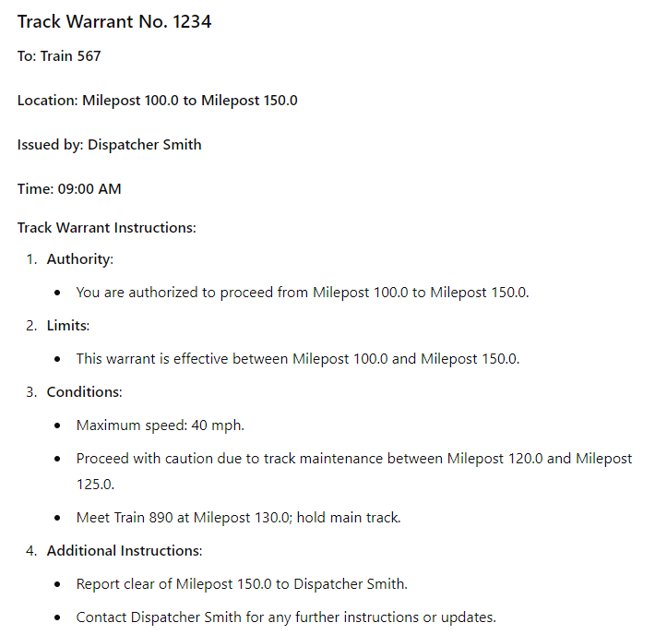
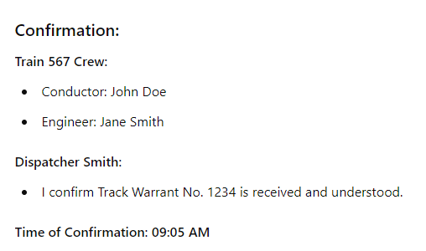
Planning for operations (cont) prompt: example of a track warrant

Slide 49
Social media

Slide 50
Write a Blog
Prompt: write a short blog about model railroading to get kids interested in the hobby
All Aboard! Discover the Magic of Model Railroading for Kids
What is Model Railroading?
Model railroading is like having a mini railway system right at your fingertips. Design and build tiny trains, tracks, and landscapes, creating a world where your trains can travel. Imagine creating a bustling city, serene countryside, or a mountain pass with tunnels and bridges.
Why is it Fun?
Creativity Unleashed: Paint your trains, design unique landscapes, and build miniature towns.
Building Skills: Assemble tracks and trains—like building with LEGO but on a whole new level.
Adventures in History: Recreate scenes from the past and learn about the history of trains.
Tech Magic: Modern model railroading includes cool tech like remote controls and digital sound effects.
How to Get Started
Choose Your Train Set: Start with a basic train set, including a train, tracks, and some scenery.
Create Your Layout: Decide on the track design. Will it go through mountains, over bridges, or around a city? Draw your ideas on paper first.
Build Your World: Use model trees, buildings, and people to create your landscape. You can even make buildings from cardboard and paint.
Run Your Train: Set up the track, place your train on the rails, and watch it go! Adjust the speed, change direction, and make stops at tiny stations.
Fun Ideas to Try
Race with Friends: Set up two tracks and see whose train is the fastest.
Create a Story: Make a storyline for your trains. Maybe one is a delivery train carrying important cargo, or another is a passenger train taking people on vacation.
Seasonal Scenes: Decorate your layout for different seasons or holidays. Add snow for winter, flowers for spring, or pumpkins for Halloween.
Join the Club!
Many towns have model railroading clubs where you can meet other kids and adults who love trains. These clubs often have huge layouts you can help build and run. Plus, you’ll get lots of tips and ideas to make your model railroad even more awesome.

Slide 51
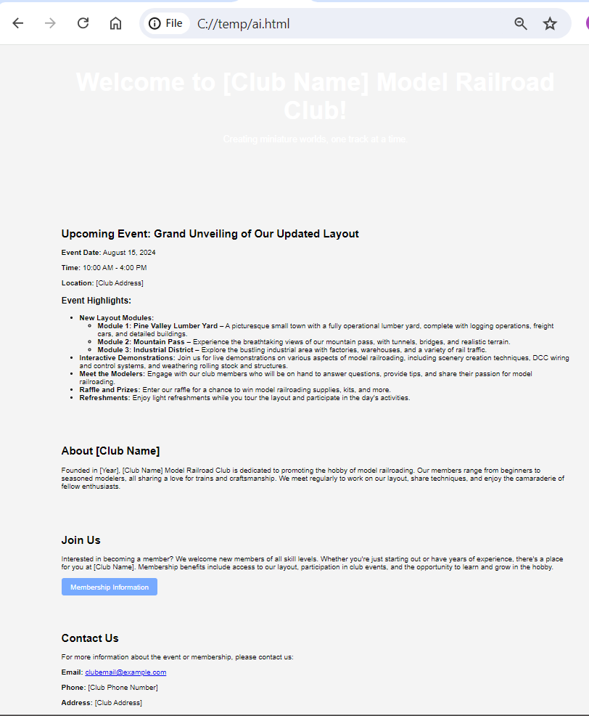
Write a Newsletter
Prompt: write a short blog about model railroading to get kids interested in the hobby

Slide 52
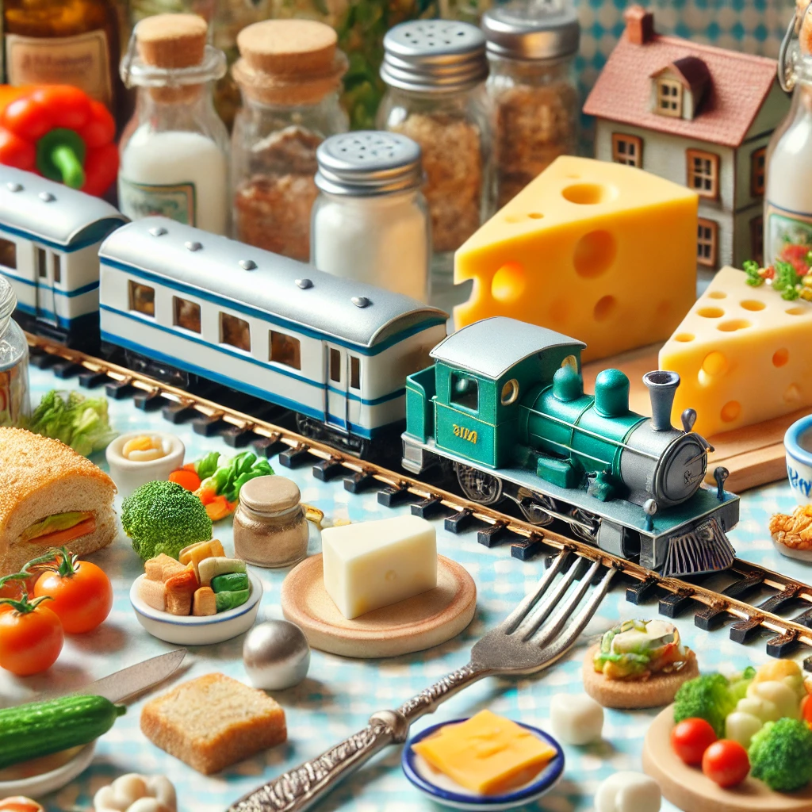

Newsletter: Humor
Prompt: show humor pics for presentation
PROMPT: image for picture 4
PROMPT: FOR PICTURE 5
Here's a humorous idea for a model railroading presentation that can be included in a PowerPoint:
Slide: "Model Railroading Mishaps and Funny Moments"
Picture 1:
Description: A cartoon-style image of a model train set running off the track, with a tiny conductor waving frantically. Caption: "When you forget to secure the tracks!"
Picture 2:
Description: An exaggerated scene of a cat lounging on a model train layout, with trains and buildings in disarray. Caption: "Feline urban renewal project in progress."
Picture 3:
Description: A model train enthusiast with a magnifying glass and a puzzled look, surrounded by tiny tools and scattered train parts. Caption: "Just a quick fix, they said."
Picture 4:
Description: A model train set running through a miniature kitchen, complete with tiny food items and utensils. Caption: "When the layout doubles as a dinner table."
Picture 5:
Description: A tiny model figure holding a sign that says "Help!" as a large hand reaches down to adjust the tracks. Caption: "Emergency maintenance in progress."
Would you like me to generate one of these images for you? If so, which one?

Slide 53
Electronics & software

Slide 54
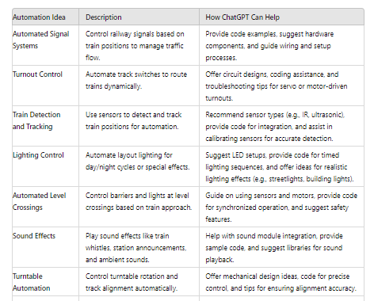
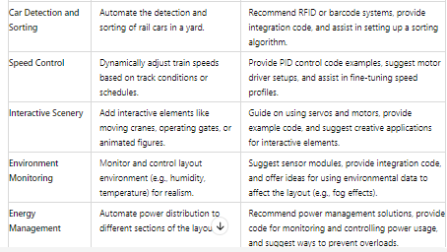
Transformation: automation
PROMPT: Table of ideas for arduino based automation

Slide 55
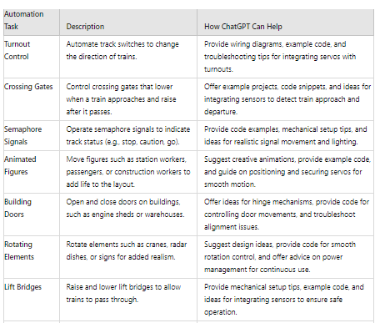
Transformation: automation (cont.)
PROMPT: Guide on using servos and motors, provide example code, and suggest creative applications for interactive elements.
1. Introduction to Servos and Motors
Servos:
Description: Servos are small, reliable actuators used for precise control of angular or linear position, velocity, and acceleration.
Types: Standard servos (180-degree rotation), continuous rotation servos (full rotation).
Applications: Turnout control, moving gates, animated figures.
Motors:
Description: Motors convert electrical energy into mechanical motion and are used for tasks requiring continuous rotation.
Types: DC motors, stepper motors, geared motors.
Applications: Conveyor belts, turntables, rotating cranes.
2. Components Needed
Arduino board (Uno, Mega, etc.)
Servos (e.g., SG90 for small applications)
Motors (DC motors or stepper motors)
Motor driver (e.g., L298N for DC motors)
Power supply (appropriate for motors/servos)
Breadboard and jumper wires

Slide 56
Transformation: automation (cont.)
PROMPT: Guide on using servos and motors, provide example code, and suggest creative applications for interactive elements.
const int motorPin1 = 2; // IN1 on L298N
const int motorPin2 = 3; // IN2 on L298N
void setup() {
pinMode(motorPin1, OUTPUT);
pinMode(motorPin2, OUTPUT);
}
void loop() {
digitalWrite(motorPin1, HIGH); // Rotate motor forward
digitalWrite(motorPin2, LOW);
delay(2000); // Run for 2 seconds
digitalWrite(motorPin1, LOW); // Stop motor
digitalWrite(motorPin2, LOW);
delay(1000); // Wait for 1 second
digitalWrite(motorPin1, LOW); // Rotate motor backward
digitalWrite(motorPin2, HIGH);
delay(2000); // Run for 2 seconds
digitalWrite(motorPin1, LOW); // Stop motor
digitalWrite(motorPin2, LOW);
delay(1000); // Wait for 1 second
}
DC Motor Setup:
Connections:
Motor Driver Inputs: Connect to Arduino digital pins.
Motor Outputs: Connect to motor terminals.
Power: Connect external power supply to motor driver.
Motor Driver: (L298N)
--------------------
IN1: Digital Pin 2 (Arduino)
IN2: Digital Pin 3 (Arduino)
OUT1: Motor Terminal 1
OUT2: Motor Terminal 2
+12V: External Power Supply
GND: External Power Supply Ground

Slide 57
Transformation: automation (cont.)
PROMPT: Guide on using servos and motors, provide example code, and suggest creative applications for interactive elements.
Components Needed:
Arduino (e.g., Arduino Uno)
5V relay module
Jumper wires
Breadboard (optional)
#include <Servo.h>
Servo myServo; // Create a servo object
void setup() {
myServo.attach(9); // Attach servo to pin 9
}
void loop() {
myServo.write(0); // Move servo to 0 degrees
delay(1000); // Wait for a second
myServo.write(90); // Move servo to 90 degrees
delay(1000); // Wait for a second
myServo.write(180); // Move servo to 180 degrees
delay(1000); // Wait for a second
}
Servo Setup:
Connections:
Power (Red): Connect to 5V on Arduino.
Ground (Brown): Connect to GND on Arduino.
Signal (Orange): Connect to a PWM pin on Arduino (e.g., pin 9).
Servo: (SG90)
--------------
Red wire: +5V (Arduino)
Brown wire: GND (Arduino)
Orange wire: PWM Pin 9 (Arduino)

Slide 58
ARDUINO Example: Controlling a relay for lighting
PROMPT: show me how to control a 5v relay using an arduino, including the code and wiring
Certainly! Here is a step-by-step guide on how to control a 5V relay using an Arduino, including the necessary wiring and code.
Components Needed:
Arduino (e.g., Arduino Uno)
5V relay module
Jumper wires
Breadboard (optional)
Wiring:
Relay Module:
VCC pin of the relay to the 5V pin on the Arduino.
GND pin of the relay to the GND pin on the Arduino.
IN pin of the relay to a digital pin on the Arduino (e.g., pin 7).
Load Connection (e.g., a light bulb):
One terminal of the load to the COM (Common) pin of the relay.
The other terminal of the load to the power source (e.g., live wire for AC or positive terminal for DC).
NO (Normally Open) pin of the relay to the neutral wire (for AC) or ground (for DC).
const int relayPin = 7; // Pin connected to the relay module's IN pin
void setup() {
pinMode(relayPin, OUTPUT); // Set relay pin as an output
digitalWrite(relayPin, LOW); // Initialize relay to be off
}
void loop() {
digitalWrite(relayPin, HIGH); // Turn relay on
delay(1000); // Wait for 1 second
digitalWrite(relayPin, LOW); // Turn relay off
delay(1000); // Wait for 1 second
}

Slide 59
Collectors: Assistance
PROMPT: provide a google sheets template for collectors
To create this template in Google Sheets, follow these steps:
Open Google Sheets.
Click on Blank to create a new spreadsheet.
Copy the headers and sample data from the table above into the first sheet.
Adjust column widths and formatting as needed.
Additional Tips:
Item ID: Unique identifier for each item in your collection.
Category: Type of item (e.g., Locomotive, Freight Car, Passenger Car).
Manufacturer: Company that made the model.
Model: Specific model name or type.
Road Name: Railroad company the model represents.
Road Number: Number printed on the model.
Scale: Model scale (e.g., HO, N, O).
Condition: Current condition of the model.
Purchase Date: Date when the model was acquired.
Purchase Price: Amount paid for the model.
Current Value: Estimated current value of the model.
Location: Where the model is stored/displayed.
Notes: Additional information about the model.
Photo: Link to a photo of the model (you can upload photos to Google Drive or another service and include the link here).
You can expand this template by adding more columns for other details you want to track, such as maintenance records, custom modifications, or historical significance.

Slide 60
exhibitors: Assistance
PROMPT: suggestions on exhibiting a club layout at a show
Staffing
Knowledgeable Members: Ensure club members are available to answer questions, provide demonstrations, and share insights about the layout and the hobby.
Rotating Shifts: Organize shifts for club members to ensure that the booth is always staffed while allowing everyone to enjoy the show.
5. Engagement
Promotional Material: Distribute flyers or brochures about your club, including information on how to join, meeting times, and upcoming events.
Live Demonstrations: Schedule regular demonstrations or operating sessions to show different aspects of the layout, such as switching operations or realistic train running.
Q&A Sessions: Host short Q&A sessions where visitors can ask questions about the layout, techniques used, and the hobby in general.
6. Maintenance
On-site Repairs: Bring a toolkit and spare parts for any on-the-spot repairs or adjustments that may be needed.
Cleanliness: Keep the layout clean and tidy throughout the show. Regularly dust and inspect the tracks and scenery.
7. Promotion and Coverage
Social Media: Promote your exhibit on social media platforms before and during the show. Share photos and live updates to attract more visitors.
Media Coverage: Invite local media to cover the exhibit. Provide them with press releases and high-quality images of your layout.
8. Follow-Up
Feedback: Collect feedback from visitors to understand what they enjoyed and what could be improved. Use this information to enhance future exhibits.
Thank You Notes: Send thank-you notes or emails to show organizers and volunteers who helped make the exhibition a success.
Exhibiting a model railroad club layout at a show requires careful planning and attention to detail to ensure that it is both impressive and enjoyable for the attendees. Here are some suggestions to help you successfully exhibit your club layout:
1. Planning and Preparation
Layout Design: Ensure your layout is modular for easy transport and assembly. Use a tried-and-tested design that highlights key features and scenic elements.
Theme and Story: Develop a theme or narrative for your layout to engage visitors. It could be based on a specific historical period, location, or type of railroad operation.
Documentation: Prepare detailed documentation, including track plans, a list of features, and a brief history or description of the layout for display.
2. Logistics
Transportation: Arrange for safe and secure transportation of the layout modules. Use padded cases or custom crates to protect delicate parts.
Setup and Teardown: Allocate sufficient time and personnel for setting up and dismantling the layout. Create a checklist to ensure all components and tools are brought to the show.
Power Supply: Ensure you have adequate power supplies and backup options. Test the electrical system thoroughly before the show.
3. Presentation
Backdrop and Lighting: Use a professional backdrop to enhance the visual appeal. Set up proper lighting to highlight key areas and create an immersive experience.
Signage: Clearly label different sections of the layout and provide informative signs about features and operations. Use large, readable fonts and high-quality prints.
Interactivity: Include interactive elements like buttons for sound effects or train controls to engage visitors, especially children.

Slide 61
photography: Assistance
PROMPT: Recommend techniques for model railroad photography
4. Focus and Depth of Field
Manual Focus: Use manual focus to ensure critical parts of the scene are sharp, especially when working with small subjects.
Focus Stacking: Take multiple shots at different focus points and blend them in post-processing to achieve a fully sharp image.
5. Backdrop and Scenery
Realistic Backdrops: Use printed backdrops that match the theme and scale of your layout. Ensure they blend seamlessly with the foreground.
Scenic Details: Add detailed scenery elements like trees, buildings, and figures to enhance the realism of your shots.
6. Post-Processing
Editing Software: Use software like Adobe Lightroom or Photoshop to enhance your photos. Adjust brightness, contrast, and colors to make your images pop.
Crop and Straighten: Crop out any distracting elements and straighten the horizon or tracks for a polished look.
Sharpening and Noise Reduction: Apply sharpening to enhance details and use noise reduction to clean up any graininess.
7. Special Effects
Weathering and Aging: Apply weathering techniques to your models for a more realistic appearance in photos.
Smoke and Steam: Use cotton or smoke machines to simulate steam and smoke effects for added realism.
Night Shots: Experiment with night scenes by using small LED lights in buildings and along streets. Adjust your camera settings to capture the ambiance.
8. Experiment and Practice
Different Scenarios: Capture a variety of scenes such as busy stations, quiet rural areas, or industrial zones.
. Lighting
Natural Light: Utilize natural light when possible. Position your layout near windows to take advantage of sunlight. Morning or late afternoon light can add a warm, realistic glow.
Artificial Lighting: Use LED lights to illuminate your layout evenly. Avoid harsh shadows and ensure the entire scene is well-lit.
Softbox/Light Diffusers: Use softbox lights or diffusers to soften the light and reduce harsh shadows. This creates a more natural look.
Reflectors: Use white reflectors to bounce light into shadowed areas, ensuring even illumination.
2. Camera Settings
Aperture: Use a small aperture (high f-stop number) to achieve a greater depth of field, ensuring more of the scene is in focus.
Shutter Speed: Use a tripod and slow shutter speed for sharp images. For moving trains, a faster shutter speed will prevent motion blur.
ISO: Keep the ISO setting low to minimize grain and ensure clear, sharp images.
3. Composition
Rule of Thirds: Divide your frame into thirds, both horizontally and vertically, and place key elements along these lines or at their intersections.
Leading Lines: Use tracks, roads, or other elements to guide the viewer's eye through the photo.
Framing: Frame your shot to include foreground, middle ground, and background elements, creating a sense of depth.
Angle and Perspective: Experiment with low angles, eye-level shots, and high angles to add variety and realism.

Slide 62
Kit building: Assistance
PROMPT: tips for assembling kits, troubleshooting common problems, and customizing kits for added realism.
Assembling Kits
Preparation
Workspace: Set up a clean, well-lit workspace with plenty of room to spread out your parts and tools.
Tools: Gather essential tools such as hobby knives, fine sandpaper, files, tweezers, glue, and a set of small screwdrivers.
Instructions: Read through the entire instruction manual before starting. Familiarize yourself with the parts and steps.
Building
Part Cleanup: Remove flash (excess plastic) and mold lines from parts with a hobby knife or fine sandpaper.
Test Fit: Dry-fit parts together before gluing to ensure they fit correctly. This helps identify any potential issues before committing.
Glue Application: Use the appropriate glue (plastic cement for plastic models, cyanoacrylate for metal parts) sparingly. Apply glue to the joining surfaces, not the entire part, to avoid excess glue and mess.
Assembly Order: Follow the instructions closely. Assemble parts in the recommended order to avoid difficulties with fit and alignment later on.
Clamping: Use clamps or rubber bands to hold parts together while the glue sets to ensure a strong bond.
Troubleshooting Common Problems
Misaligned Parts: If parts do not align properly, gently sand or trim them until they fit correctly. Dry-fit often to check your progress.
Gaps and Seams: Fill gaps with model putty or filler. Sand smooth once dry to create a seamless joint.
Warped Parts: To correct warped plastic parts, carefully heat them using warm water or a hairdryer and gently bend them back into shape.
Loose Parts: For loose-fitting parts, add a small amount of putty or use a stronger adhesive to secure them.
Broken Parts: Repair broken parts by carefully gluing them back together or replacing them with scratch-built components if necessary.
Customizing Kits for Added Realism
Detailing
Fine Details: Add fine details such as handrails, grab irons, and piping using thin wire or aftermarket detail parts.
Interior Details: Enhance the interiors of buildings and passenger cars with furniture, figures, and lighting.
Window Glazing: Use clear plastic sheets or specialized glazing materials to simulate glass in windows.
Painting and Weathering
Primer: Always apply a primer before painting to ensure paint adhesion and reveal any surface imperfections that need attention.
Painting: Use an airbrush or high-quality brushes for painting. Apply multiple thin coats for a smooth, even finish.
Decals: Apply decals after painting. Use decal setting solutions to help them conform to surface details and avoid a "sticker" appearance.
Weathering: Add weathering to give your models a realistic, used look. Techniques include:
Dry Brushing: Lightly brush on small amounts of paint to highlight raised details.
Wash: Apply a thin wash of diluted paint to bring out recessed details and add depth.
Powders: Use weathering powders to simulate dirt, rust, and grime. Apply sparingly and fix in place with a clear flat coat.
Chipping: Simulate paint chips and wear using a fine brush or sponge with a contrasting color.
Custom Modifications
Kitbashing: Combine parts from different kits to create unique models that fit your layout’s specific needs.
Scratch Building: Add custom components made from styrene, wood, or metal to enhance or modify kit elements.
Lighting: Install LED lights for realistic illumination. This can include interior lights for buildings and passenger cars, or exterior lights like street lamps.

Slide 63
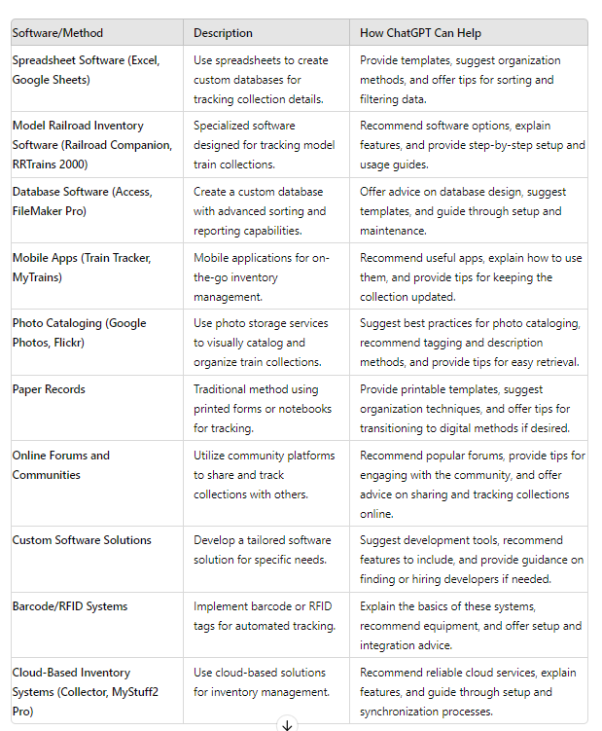
Education: upload a PDF
PROMPT: summarize the articles in the attached pdf.
ICON:
Upload files
The PDF file "067.RE-2024-06-A.pdf" from the June 2024 issue of MRH Running Extra magazine contains various articles on model railroading. Here is a summary of the key articles included:
Limited Modeler: Great Small Layout Examples
Author: Jim Six
Content: Focuses on small layouts, particularly one-town layouts. Highlights include Tom Johnson's Cass County layout and Robin Mountenay's recent projects. The article discusses the challenges and strategies in simplifying and managing small layouts while maintaining realism and operational interest.
Getting Real: Two Unique Prototype Industries
Author: Greg Baker
Content: Explores two prototype industries and their operations. Provides detailed site maps, photos, and contaminants lists, which are useful for creating accurate models of these industrial facilities. The article emphasizes the importance of capturing the essence and operational characteristics of real industries in model form.
….<more>

Slide 64
Summary: How ChatGPT Supports Your Layout
Get era-accurate freight ideas
Generate newsletters and signs
Help plan industries and yards
Code for animations, lighting, sound
Troubleshoot wiring or Arduino issues
Write posts and help answer forum questions
Stay inspired when you’re stuck

Slide 65
Q & A
Creating Low Cost Circuits and PCBs using Fritzing
Wednesday, 8/7/2024 9:30am to 12:30
Room: Shanghai
Friday, 8/9/2024 3:30pm - 6:30pm
Room: Tokyo

Slide 66
THANKS !

